Slide 1
Online School Management System
Preformed by:
Mihir Patel (19IT104)
Dharmik Patel (19IT094)

Slide 2
introduction
A School management system is a database system which can use for managing school’s work.
The School authority can utilize this tool to access the process of student within the school.
Principle and the management team of school monitor of the student within the school using SMS.
SMS will help in maintaining the details retailed to attendance and basic detail of student

Slide 3
objective
It provides better and efficient services.
Reduce the workload of an school .
Faster way to get information about the students.
Provide facility for proper monitoring and reduce paper work.
All details will be available on a click for admin.

Slide 4
Motivation
Government is working on a developed strategy which aims the development of ICT structures in all the high schools of the country.
Most of the high schools are already equipped with necessary hardware and network structures under the supervision of the Ministry of Education.

Slide 5
Module
Login Page
Add Student
Update Student
Student Details
Student Attendance
Enter Marks
Marks Details
About us

Slide 6
Methodology
Technology : This system development purpose it uses simple to use & easily available technology. This system is based on windows like interface, which is very easy to use. This system developed by Programming language Java and Database MySQL Server.
Object Oriented Modeling Technique.

Slide 7
Future work
Make the system more user friendly.
Make the system accessible through cell phone or tablets.
Make the system accessible from any place.
Incorporate other services like automated time table generate.

Slide 8
References
https://www.javatpoint.com/java-swing
https://www3.ntu.edu.sg/home/ehchua/programming/java/j4a_gui.html
https://en.m.wikipedia.org/wiki/School_Information_Management_System

Slide 9
Conclusion
School Management Systems are being identified as an appropriate method for managing information in schools.
SMS was built based on real life situations, taking into consideration all possible situations and functionalities of the daily work in these schools.
This system considered as a good first step in implementing performing online based information management in schools.

Slide 10
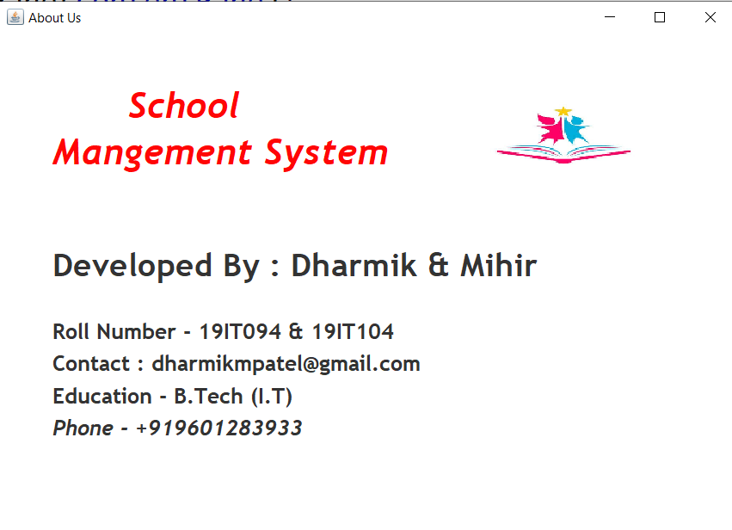
Snapshots

Slide 11
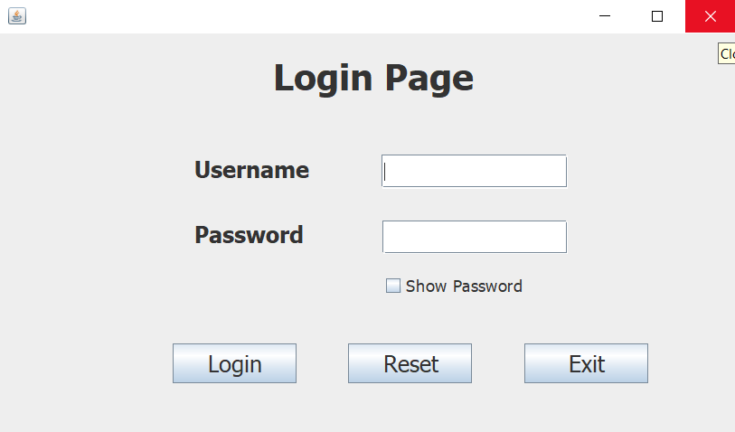

Slide 12
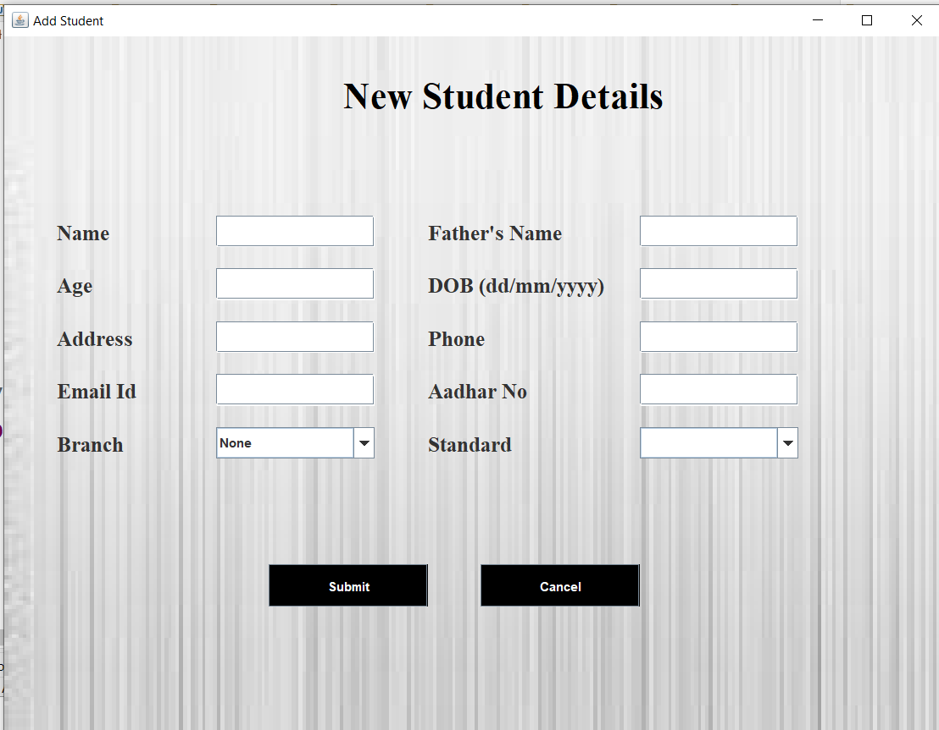

Slide 13
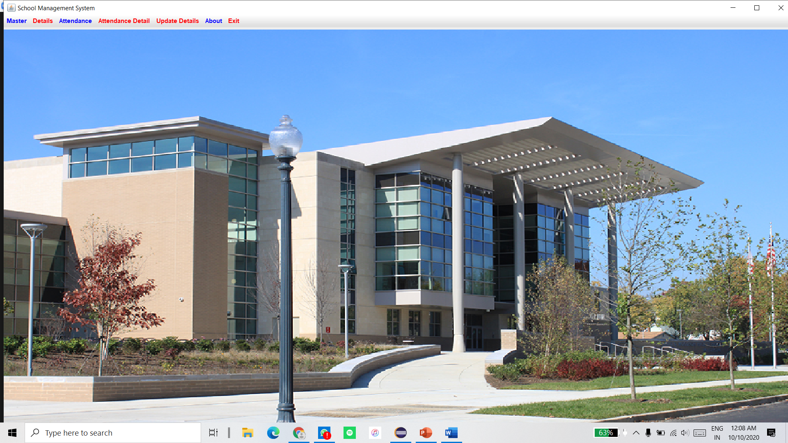

Slide 14
Thank you

